Slide 1







Forward-Forward
Agenda
1. Summary
2. Approach
3. Backpropagation
A use case comparison against Backpropagation
4. ForwardForward
5. Models Implementation
6. Peculiarities
7. Conclusions
Prof. Spampinato Concetto
Prof. Pennisi Matteo
Incardona Biagio
1000023753

Slide 2
Forward-Forward
Agenda
1. Summary
2. Problem Description
3. Approach
A use case comparison against Backpropagation
4. Backpropagation
5. Forward-Forward
6. Models Implementation
7. Peculiarities
Prof. Spampinato Concetto
Prof. Pennisi Matteo
Incardona Biagio
1000023753

Slide 3
Summary
A Decorator class for each typology has been implemented
FF models have had on average 10-15PP less accuracy than BP
Time complexity increase for FF tends to be inconsistent
Time complexity increase for BP is linear
Time complexity increase for FF is linear but with a higher slope than BP

Slide 4





Problem Description
Problem
The goal of this presentation is to evaluate the performances of a model trained with the Forward-Forward algorithm applied to a multiclass classification problem using the CIFAR-10 Dataset.
The Performances will then be compared to a model trained using the Backpropagation algorithm
What is it
Dataset Description
How it works
CIFAR-10 is an established computer-vision dataset used for object recognition. It is a subset of the 80 million tiny images dataset and consists of 60,000 32x32 color images containing one of 10 object classes, with 6000 images per class.
Notes:
4

Slide 5
Approach
Accuracy
Train different model architectures for both BP and FF
Compare the results on training and validation set
Compare test set results of FF and BP
Retrain the best model
What is it
How it works
Time
Train different sized single layer models for both BP and FF
Analyse single epoch training time vs layer size
Compare results of
FF and BP
Notes:
5

Slide 6
Backpropagation
Iterative algorithm used to train Deep Neural Networks
1. Forward pass: Compute network output using current weights
Optimizes the parameters by minimizing the prediction error
2. Error Calculation: Calculate error w.r.t. the expected output
What is it
How it works
Error gets minimized by the calculation of gradients
3. Backward pass: error get propagated backward upgrading the weights using the gradients

Slide 7

Forward-Forward
Introduction
Introduced by Geoffrey Hinton
New learning procedure for neural networks
Each layer trained independently
Iterative algorithm used to train Deep Neural Networks
1. Forward pass: Compute network output using current weights
Optimizes the parameters by minimizing the prediction error
2. Error Calculation: Calculate error w.r.t. the expected output
Error gets minimized by the calculation of gradients
3. Backward pass: error get propagated backward upgrading the weights using the gradients

Slide 8
Forward-Forward
Preliminary information
The term Positive data is intended as real data
The term Negative data is intended as fake data
Negatives Generation
automatically by the network
Ad-hoc made by the engineer
i.e. assigning wrong labels on purpose
Iterative algorithm used to train Deep Neural Networks
1. Forward pass: Compute network output using current weights
Optimizes the parameters by minimizing the prediction error
2. Error Calculation: Calculate error w.r.t. the expected output
Error gets minimized by the calculation of gradients
3. Backward pass: error get propagated backward upgrading the weights using the gradients

Slide 9
Forward-Forward
Training Procedure
1st Forward pass: Compute layer output with real data
Change weights to make goodness as higher than a threshold as possible
Two Forward Steps
Goodness higher than threshold for real data and lower for fake data
Change weights to make goodness as smaller than a threshold as possible
2nd Forward pass: Compute layer output with negative data

Slide 10
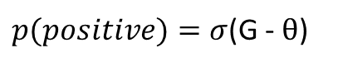
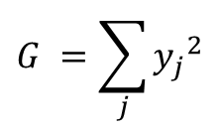
Forward-Forward
Goodness & predictions
$$G =\sum_{j}{{y_{j}}^{2}}$$
Goodness (G) is defined as the sum of squares of the activations of the layer
Probability that an input vector is positive is given by applying the
logistic function, σ to the goodness, minus some threshold, θ
$p(positive)=σ$(G - $θ$)
The negative data generation, the training procedure and the final prediction methodology varies depending on the task we are trying to solve

Slide 11
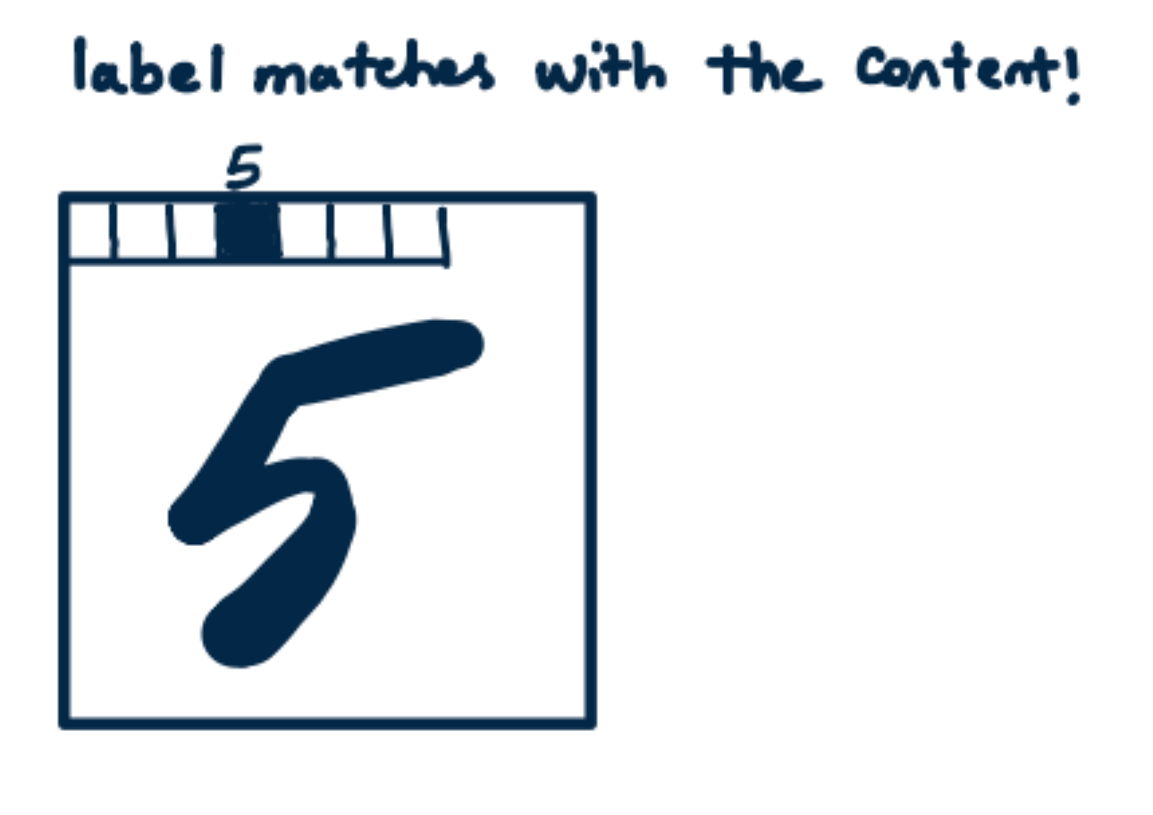
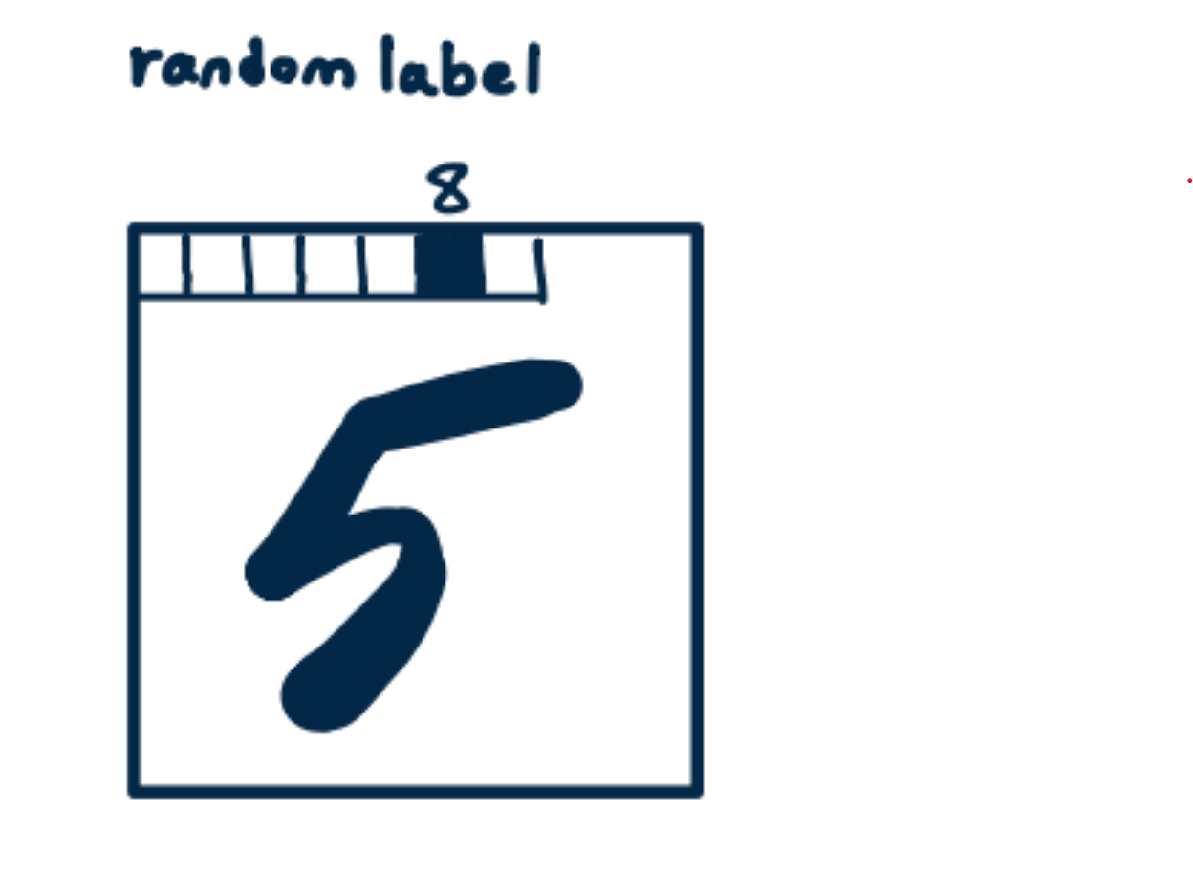
Forward-Forward
N-Class Image Classification
Real data
Prediction
For an image of class j, shut down the first N pixels but the j-th one which will get maximum brightness
Shut down the first N pixels
brighten, one at time, all the first N pixels of the image
Feed the images, one at time, to the network
Select as final prediction the class for which the goodness is higher
Fake data
For an image of class j, shut down the first N pixels but a random one different than the j-th

Slide 12
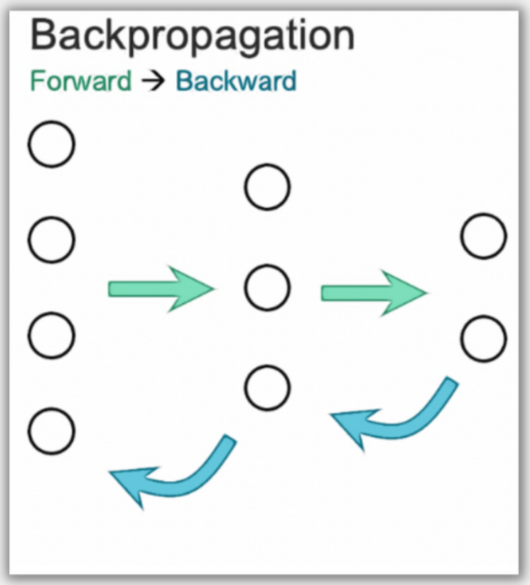
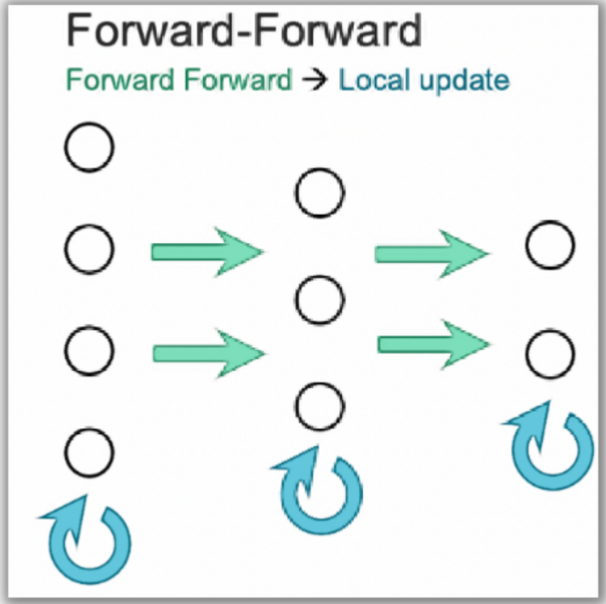
Forward-Forward
Main Characteristics
Local Training: Doesn’t need to know the full computation of the output of the network to update the weights of the layers. We just need to compare the output of positive and negative data.
Memory Efficiency: Storing of the activation functions is not needed, making the training more memory efficient

Slide 13
Models Implementation
Forward-Forward
Backpropagation
# Inner Layers 1
# Inner Layers 2
Layer dimensions 3072x800
Layer dimensions 3072x800|800x10
Layer LR 0.1
Network LR 0.005
Layer TH 5
Network Momentum 0.5
Layer epochs 35
Network epochs 30
Training Accuracy ≈59%
Training Accuracy ≈61%
Validation Accuracy ≈50%
Validation Accuracy ≈54%
Test Accuracy ≈59%
Test Accuracy ≈59%

Slide 14
Peculiarities
Extra Layers
From the tests to build the final model it has shown that adding a second layer doesn’t almost any advantage in terms of performances
Training Time
The time complexity of training a single layer increases linearly with the increasing of the layer size, as for BP, but with a noticeably higher slope
Notes:
14

Slide 15
Conclusions
No specific improvement over BP
FF models has had on average 10-15PP less accuracy than BP
Time complexity increase for FF tends to be inconsistent
Time complexity increase for BP is linear
Time complexity increase for FF is linear but with a higher slope than BP
Notes:
15

Slide 16
Thank you for the Attention
Notes:
16

